Slide 1
Exploring the Filter Bubble: The Effect of Using Recommender Systems on Content Diversity
Date: 2014/8/25
Author: Tien T.Nguyen, Pik-Mai Hui, F. Maxwell Harper, Loren Terveen, Joseph A. Konstan
Source: WWW’14
Advisor: Jia-Ling Koh
Speaker: Pei-Hao Wu

Slide 2
Outline
Introduction
Data and Method
Result
Conclusion

Slide 3
Introduction
Motivation
1. Recommender systems provide users with personalized information offerings
2. Researchers have wondered whether recommender systems become more narrow over time

Slide 4
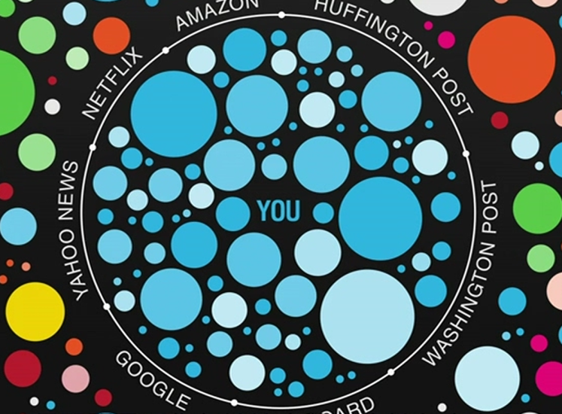
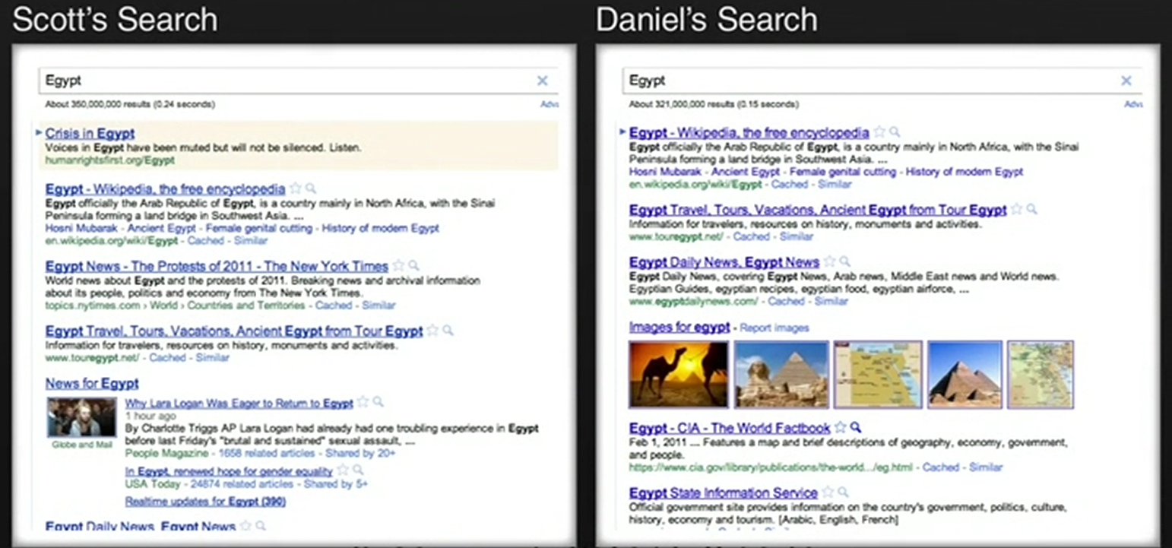
Introduction
Filter Bubble

Slide 5
Introduction
Questions
1. Do recommender systems expose users to narrower content over time?
2. How does the experience of users who take recommendations differ from that of users who do not regularly take recommendations?

Slide 6
Outline
Introduction
Data and Method
Result
Conclusion

Slide 7
Data
MovieLens
Longitudinal data
Top Picks For You
A recommender system with a well-know recommender engine
Collaborative filtering algorithm
An expressive way to compute content diversity
Tag-genome

Slide 8
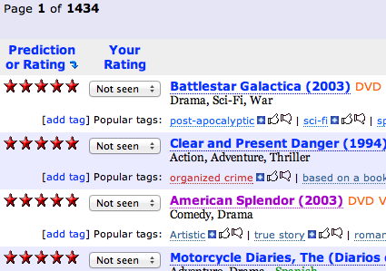
Longitudinal data
Top Picks For You
Display movie the user has not seen
Ordered predicted ratings from the highest to the lowest

Slide 9
An expressive way to compute content diversity
Tag-genome
Help users navigate and choose movies
An expressive way to characterize movie content

Slide 10
Identifying recommendation takers
Rating Block
Remove the first 15 ratings
Remove all of the ratings from the first three months
10 ratings per rating block
Drop the last not enough 10 block
1405 users
173010 ratings on 10560 distinct movies
Accessed “Top Pick For You” 150759 times

Slide 11
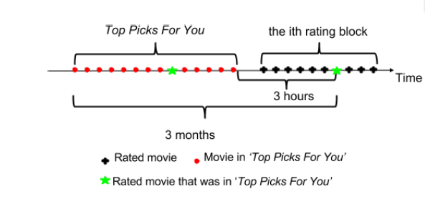
Identifying recommendation takers
Indentifying consumed recommendations in a rating block
The movie was in “Top Pick For You” between 3 hours and 3 month

Slide 12
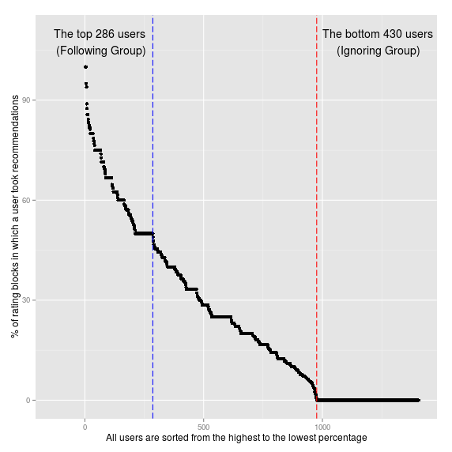
Identifying recommendation takers
Classify users
Following Group
Users took recommendations in at least 50%
286 users
Ignoring Group
Users did not take any recommendations
430 users

Slide 13
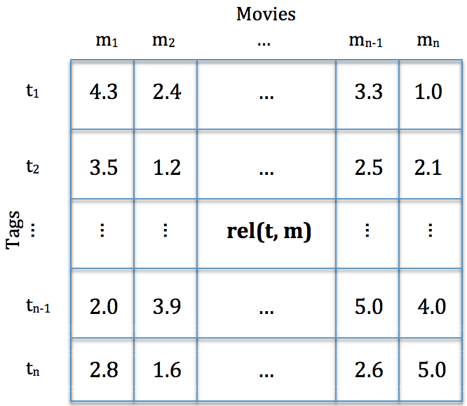
Measuring content diversity
Tag genome
The relevance score rel(t,m) takes on values from 1 to 5
Euclidean distance

Slide 14
Measuring the effect of recommender system
Content Diversity
average pair-wise distances of the movies in the list
Compute the top 15 recommended movie
User Experience
Per user rating average of movies in a given rating block

Slide 15
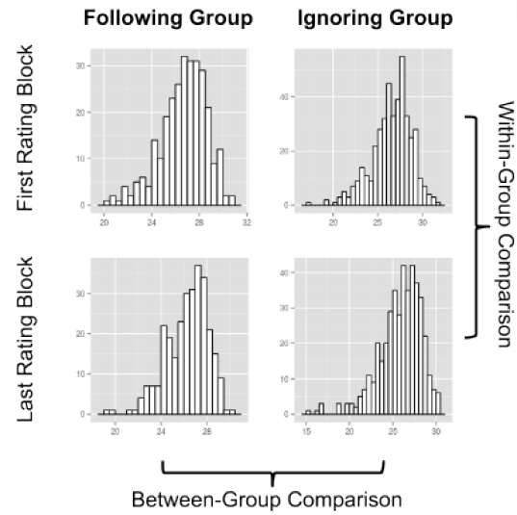
Measuring the effect of recommender system
Group Comparison
Within-group comparison
Examine content diversity of a group
Between-group comparison
Examine content diversity between two group

Slide 16
Outline
Introduction
Data and Method
Result
Conclusion

Slide 17
Question 1
Do recommender systems expose users to narrower content over time?
Yes. Compare the content diversity of recommended movies at the beginning and at the end of a rating history

Slide 18
Question 2
How does the experience of users who take recommendations differ from that of users who do not regularly take recommendations?
(a) Does taking recommendations lower the consumed content diversity?
Yes.

Slide 19
Question 2
(b) Did the Following Group have better experience?
Yes.

Slide 20
Question 2
(c) What does the change of rating average mean?
The rating changes 0.12
Define the positive experience index as the percentile of per user rating average
If the average rating of a user is at 90th percentile, that means he receives more positive experience than the rest of 90 % user
Following Group:
First: average rating of 3.69, 58.93th percentile
Last: average rating of 3.68, 57.72th percentile
Ignoring Group:
First: average rating of 3.74, 63.63th percentile
Last: average rating of 3.55, 44.77th percentile

Slide 21
Outline
Introduction
Data and Method
Result
Conclusion

Slide 22
Conclusion
Find evidence for two forms of narrowing
Recommendation-following users received more diverse top-n recommendation lists than non-following
non-following user narrowed the content diversity, but the effect was smaller than Recommendation-following
Our work has several limitations. We cannot be sure if people are really following MovieLens recommendations, since we are using log data analysis methods. Additionally, users may be influenced by recommendations from other information sources or from their friends.

